Slide 1



IMPROVING TIME SERIES CLASSIFICATION ACCURACY USING SELF-SUPERVISED LEARNING
Presentation by Saurav Raj
Deepcraft

Slide 2

BACKGROUND AND MOTIVATION
Why Self-Supervised Learning
Traditional supervised learning relies on labeled data, which is limited and costly to acquire.
Self-supervised learning (SSL) uses unlabeled data, extracting valuable features that can enhance model performance in downstream tasks.
Gesture recognition in time series data can benefit from SSL by extracting richer feature representations, improving accuracy on the UWaveGestureLibrary dataset.
Presentation by Saurav Raj | Self-Supervised Learning | Deepcraft

Slide 3
OBJECTIVE
Goal: To improve the classification accuracy of the UWaveGestureLibrary dataset using self-supervised learning.
Specific Objectives:
1. Implement SSL on an external dataset (HAR dataset) to learn feature representations.
2. Fine-tune a classification model on UWaveGestureLibrary using these learned features.
3. Quantitatively compare the performance with conventional classification methods.
Presentation by Saurav Raj | Self-Supervised Learning | Deepcraft

Slide 4


DATA PREPARATION
Datasets Used:
Dataset | Shape (Train) | Shape (Validation) | Shape (Test)
HAR | (5881, 618) | (1471, 618) | (2947, 618)
UWaveGestureLibrary | (320, 618) | (120, 618) | (120, 618)
HAR Dataset (for SSL pre-training): [HAR.zip]
UWaveGestureLibrary Dataset (for classification): [Gesture.zip]
Preprocessing Steps:
Missing Values: No missing values detected in both datasets.
Scaling: StandardScaler used for feature normalization.
Presentation by Saurav Raj | Self-Supervised Learning | Deepcraft

Slide 5
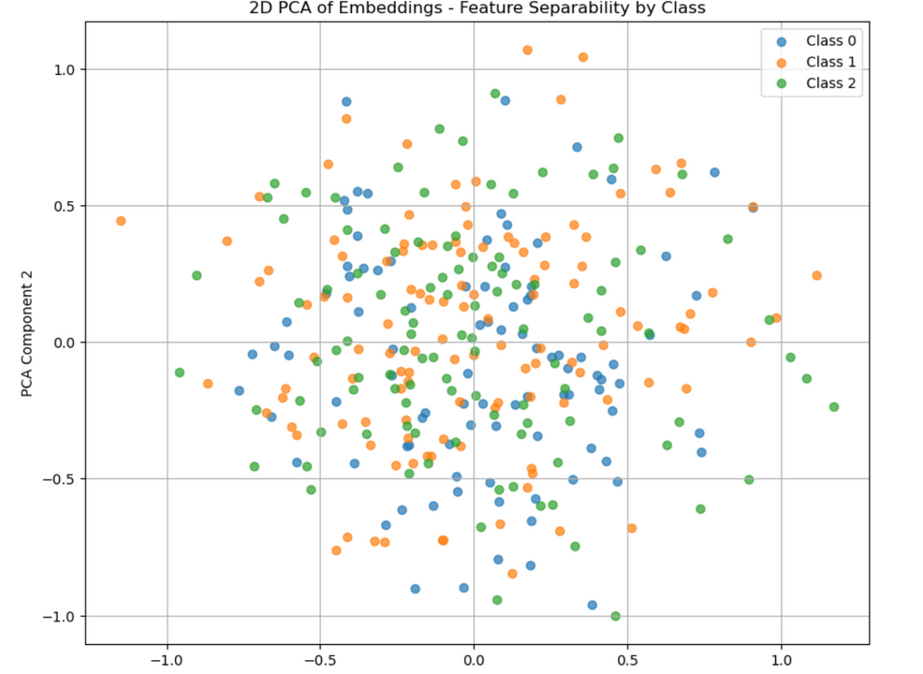
FEATURE EXTRACTION RESULTS
Embeddings: Extracted features from the UWaveGestureLibrary dataset using the trained Siamese Network.
Embeddings Shape:
Train: (320, 64)
Validation: (120, 64)
Test: (120, 64)
Presentation by Saurav Raj | Self-Supervised Learning | Deepcraft

Slide 6
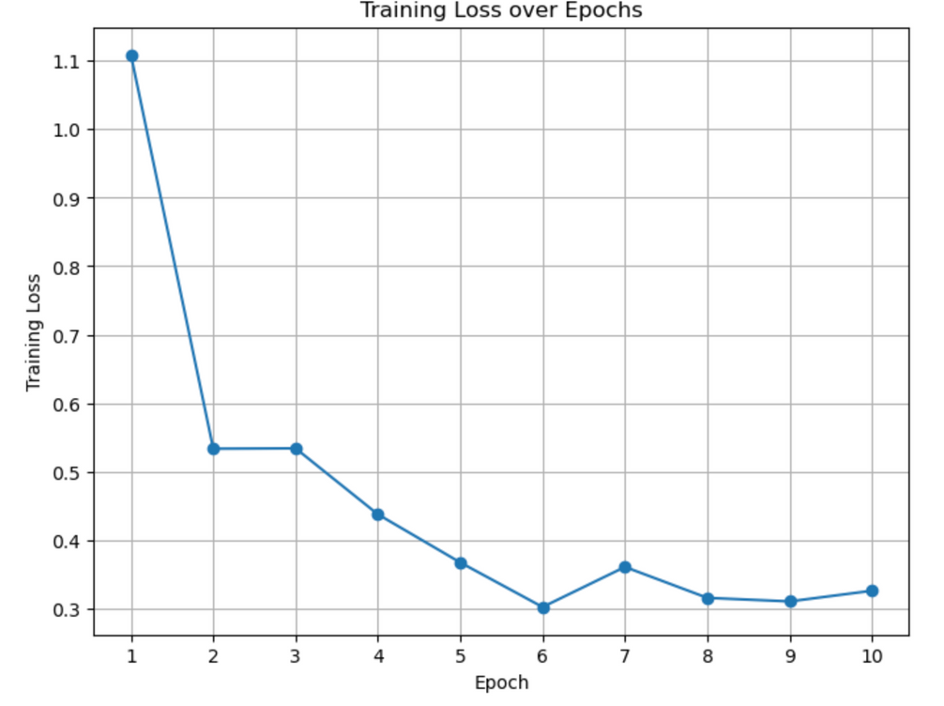
SELF-SUPERVISED LEARNING IMPLEMENTATION
Model: Siamese Network with contrastive loss (NT-Xent Loss).
Hyperparameters:
Epoch | Loss
1 | 1.1088
2 | 0.5333
3 | 0.5331
.... | ....
10 | 0.3257
• Hidden Dim: 128
• Output Dim: 64
• Temperature: 0.5
• Batch Size: 32
• Epochs: 10
Presentation by Saurav Raj | Self-Supervised Learning | Deepcraft

Slide 7
CLASSIFICATION MODEL SELECTION AND RATIONALE
Models Tested:
• Tuned Classifier (Dense Neural Network with dropout)
• LSTM-based Classifier (with Early Stopping)
Model | Train Accuracy | Validation Accuracy | Test Accuracy
Tuned Classifier | 68.75% | 66.67% | 66.67%
LSTM Classifier | 75.62% | 74.17% | 74.17%
Why LSTM?
• LSTM captures sequential dependencies in time series, which improves model interpretability and classification accuracy.
Table :Accuracy Comparison:
Presentation by Saurav Raj | Self-Supervised Learning | Deepcraft

Slide 8
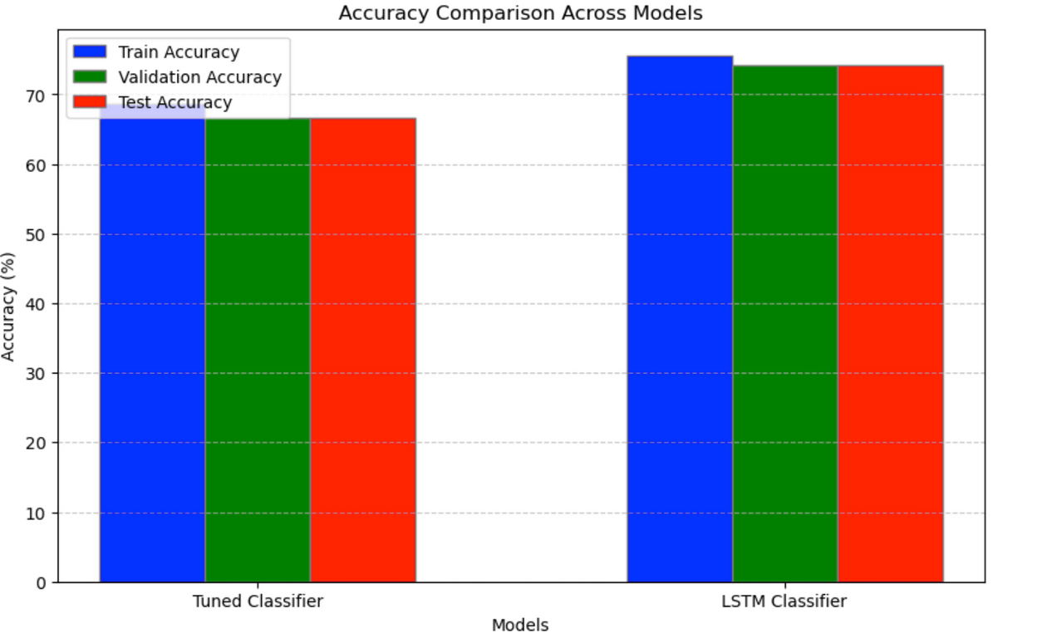
CLASSIFICATION MODEL SELECTION AND RATIONALE
LSTM Performance Improvement:
Test accuracy improved by 7.5% using LSTM over Tuned Classifier.
Early Stopping Triggered
Helps avoid overfitting by halting training early.
Presentation by Saurav Raj | Self-Supervised Learning | Deepcraft

Slide 9
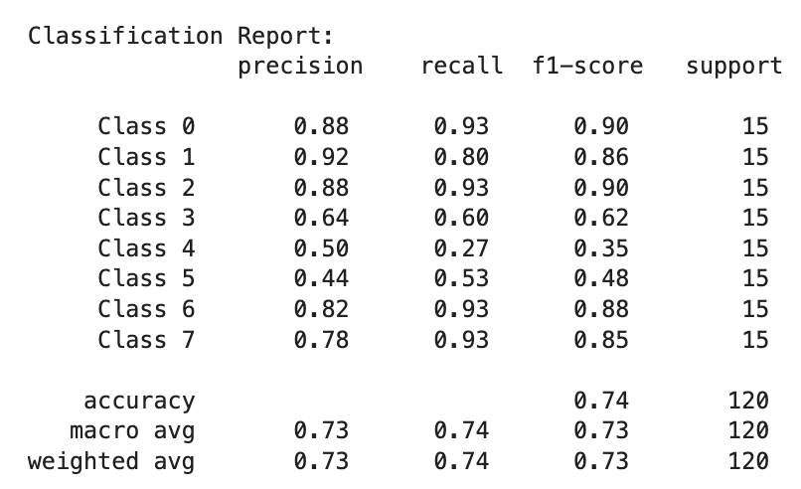
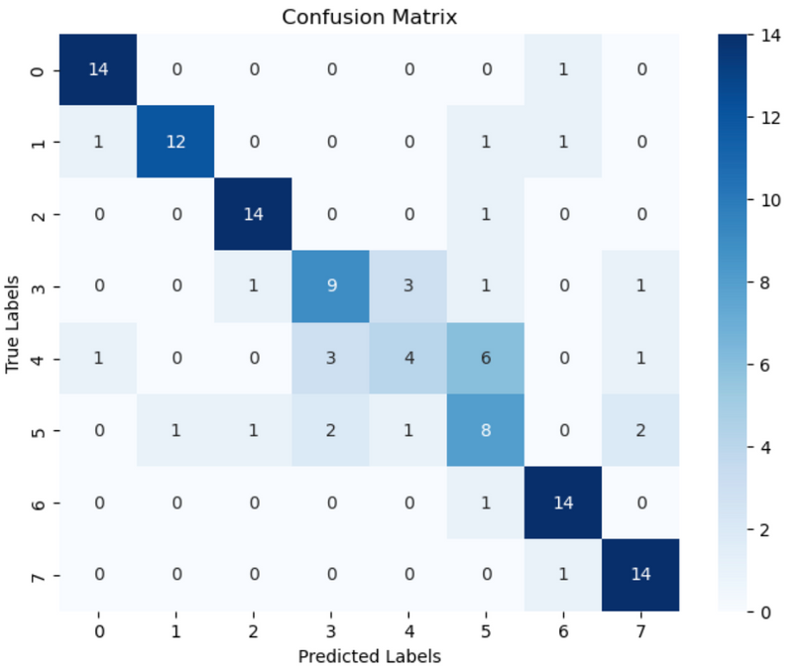
EVALUATION METRICS AND RESULTS
Metrics Used:
• Accuracy
• Confusion Matrix
• Classification Report
(Precision, Recall,
F1-score)
Presentation by Saurav Raj | Self-Supervised Learning | Deepcraft

Slide 10
MODEL INTERPRETABILITY AND ERROR ANALYSIS
Error Analysis:
Class 4 and 5 show lower F1 scores, likely due to overlap in feature space or limited distinctive features.
Potential Solution: Investigate additional feature extraction methods or different augmentations for better class separability
Presentation by Saurav Raj | Self-Supervised Learning | Deepcraft

Slide 11
SUMMARY AND CONCLUSION
Summary:
Successfully implemented self-supervised learning on HAR data.
LSTM-based classifier yielded higher accuracy and interpretability on UWaveGestureLibrary.
Key Improvements:
7.5% increase in accuracy using self-supervised learned features.
Efficient feature extraction using contrastive learning and augmentation.
Future Work:
Experiment with advanced SSL techniques like masked autoencoders or multi-task learning for further improvements.
Presentation by Saurav Raj | NTT Stock Price Prediction | Deepcraft

Slide 12
THANK YOU !
Presentation by Saurav Raj
Deepcraft

